Slide 1

RDBprocessing
a tool to improve consistency of aggregated data
2nd Training
Excelsior Hotel, Bari (Italy), 20th-24th January 2025
I. Bitetto, W. Zupa

Slide 2
Background
Some of the main advantages of a regional database is that the fisheries data (detailed and aggregated) of all types (biological, economic, etc…):
in the different formats (e. g. datacalls);
related to different Countries
are stored in a unique «box»;
This allows, from a data processing point of view to facilitate:
The extrapolate the aggregated information (e.g. raised LFDs) once and convert in the different formats;
The harmonization of data processing among the Countries;
A more transparent, tracked and documented data flow for answering to the data calls launched by end-users.

Slide 3


RDBprocessing: an R package to process data in RDBFIS
RDBFIS takes advantage from existing conversion R tools developed in STREAM (MARE/2016/22 – SI2.770115) designed for in order to ease the process of delivering datasets to the official data calls (e.g. DG MARE, FDI and GFCM) and mitigate the risk of noncompliance in the data provision.
To improve the consistency among the different data call formats, an R package (RDBprocessing) was specifically developed starting from the available STREAM conversion routines.
RDBprocessing has been integrated in the RDBFIS but is also available as a stand-alone tool to be used by MS:
https://github.com/COISPA/RDBprocessing
GFCM/ DCRF
MED & BS
FDI

Slide 4
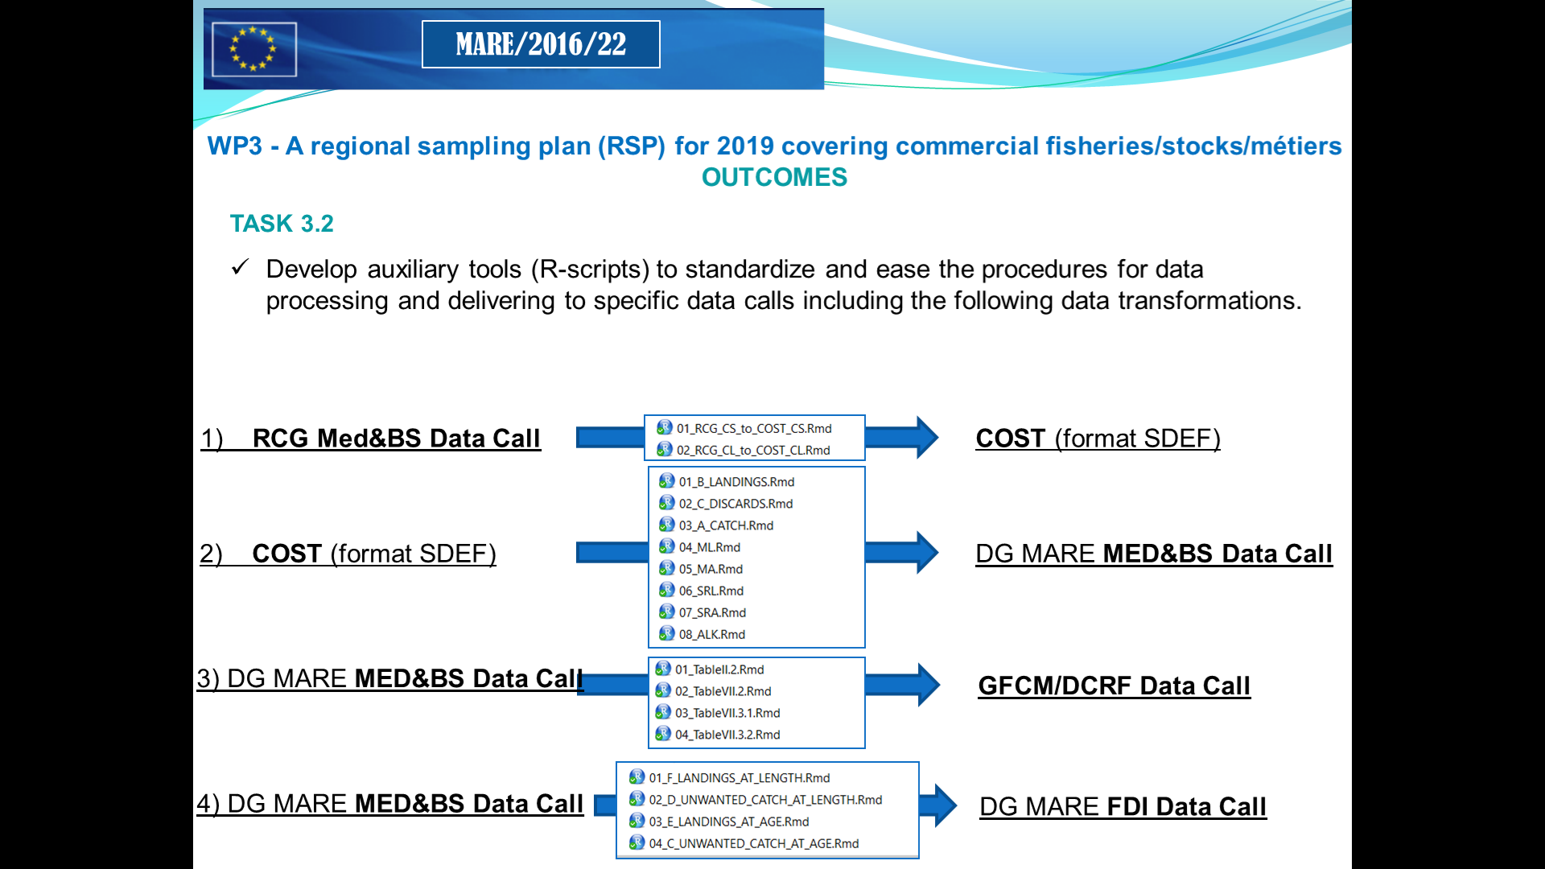
Conversion R tools developed in STREAM

Slide 5
Data processing tools implemented in RDBFIS
Supported data call formats:
Med&BS datacall (https://datacollection.jrc.ec.europa.eu/dc/medbs);
FDI datacall (https://datacollection.jrc.ec.europa.eu/dc/fdi );
GFCM DCRF data call (http://www.fao.org/gfcm/data/dcrf/platform/en/);
Starting from:
RCG (https://datacollection.jrc.ec.europa.eu/bg_BG/docs/rcg)

Slide 6
MED & BS data call
8 functions specifically implemented to compile the tables:
Table Catch data fully aggregated (sum) by ID except for mean weight and length (arithmetic mean) in landings and discards at age.
Table Landings data fully aggregated (sum) by ID.
Table Discards data fully aggregated (sum) by ID.
Table ML. Maturity ogives at Length - aggregated by length class, sex, species, start-end year, area and country where fish were caught.
Table MA. Maturity ogives at Age - aggregated by age class, sex, species, start-end year, area and country where fish were caught.
Table SRL. Sex ratio at length - aggregated by length class, species, start-end year, area and country where fish were caught.
Table SRA. Sex ratio at age - aggregated by age class, species, start-end year, area and country where fish were caught.
Table ALK. Age length key aggregated by age class, sex, species, start-end year, area and country where fish were caught.

Slide 7
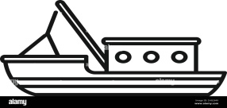
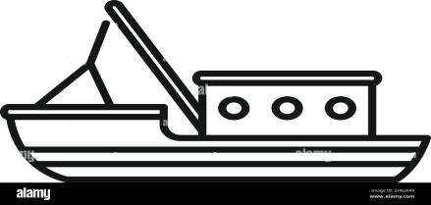

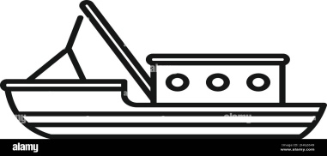
MED & BS data call
Input tables:
RCG CS detailed sampling data format
RCG CL aggregated landing data format
Effort table in COST format
Auxiliary information (included in the R package):
Last templates of the Med&BS Data Call;
Conversion table of the FISHERY codification from the RCG to the MED&BS format.
Default stratification:
Spatial stratum: GSA;
Temporal stratum: QUARTER;
Technical stratum: GEAR/METIER.
catches
sample

Slide 8
MED & BS data call
Several options of the COST package are used to implement the most common raising procedures starting directly from primary data (CS table) and data on landings (CL table) :
• Discards raising;
• Length distribution raising;
• Age structure estimation.
Estimation of landings LFDs:
RaiseLgth() COST function is used to estimate the total weight by each combination of the spatial, temporal and technical stratum, and to derive the numbers at each length class for each combination of the stratum.
Estimation of discards LFDs:
Default raising method : by trip,
Other available methods: by fishing operations, by fishing days, ratio-to-total landings and ratio-to-fishing duration.
totVolume() COST function is used to estimate the total weight by each combination of the spatial, temporal and technical strata; then the numbers at each length class for each combination of the strata are derived.
Estimation of landings and discards at age:
RaiseAge() function is used to transform the numbers at length to numbers at age for Landings and Discards.

Slide 9
FDI data call
STREAM developed R scripts that allows to create Table C. Discard biological data (age based), Table D. Discard biological data (length based), Table E. Landings biological data (age based) and Table F. Landings biological data (length based).
Nevertheless, these four tables are no longer required by Mediterranean and Black Sea, and thus have not been included in the package at this stage.
The only table required is the Catch table for which no script was available from STREAM project.
A new function has been, thus, developed from scratch to be integrated in the RDBprocessing package and in the RDBFIS platform. The function uses as input the RCG CL landing table, where the information on landing and landing value are available by metier but not by vessel length; thus, the vessel length column is reported as “NK”.
Information on the discard cannot be automatically reported, but needs to be entered a posteriori, manipulating off-line the information from MED&BS data call that not always is reported at the same aggregation level.

Slide 10
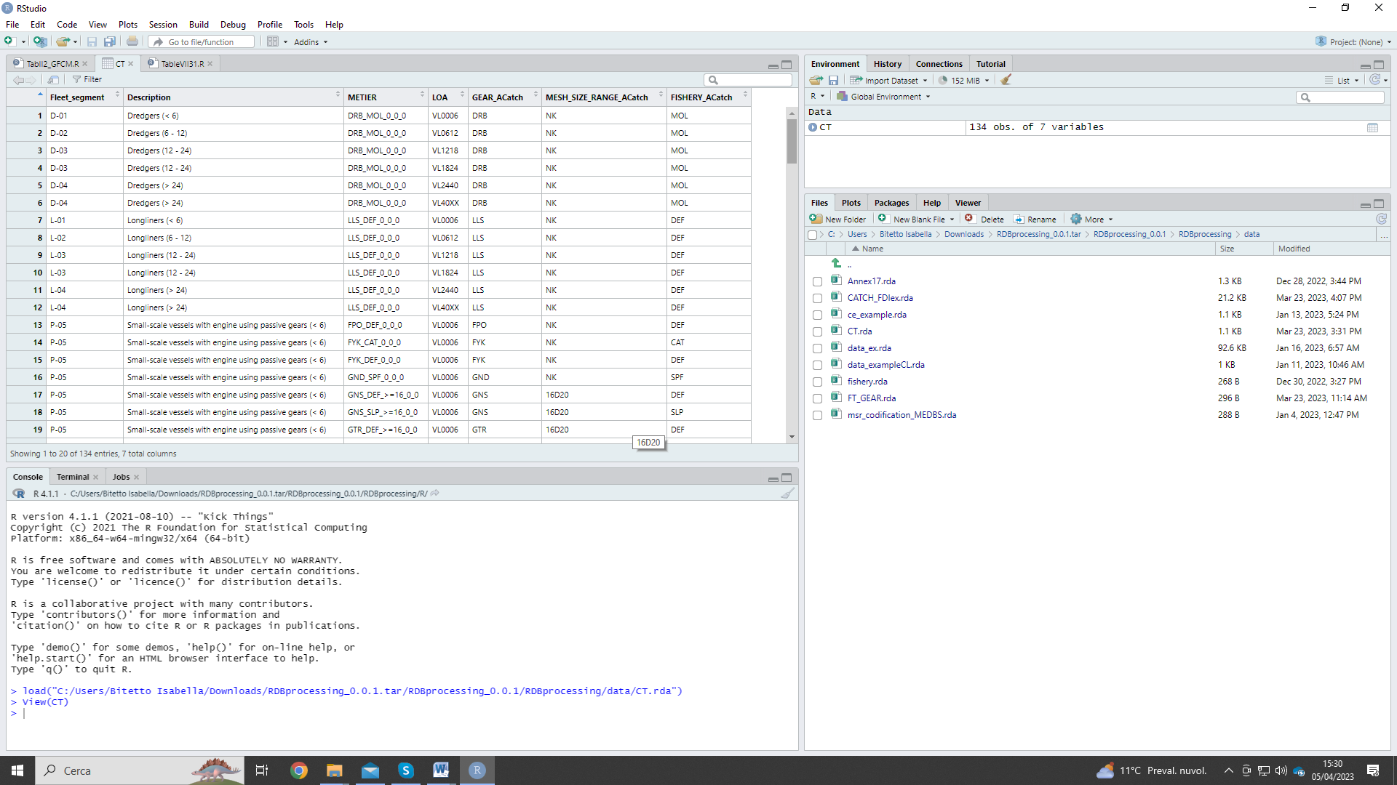
GFCM DCRF datacall
The scripts developed in STREAM were transformed in R functions and included in the RDBprocessing R package.
Specifically, the functions included in the package allow to create:
Table II.2 - Catch data per species: the total catch in weight, including landing and discards (if present and recorded), by main commercial species, fleet segment (Appendix B of GFCM DCRF) and area (GSA);
Tables VII.3.1 - Other biological data: Maturity data table (species of Group 1 Appendix A of GFCM DCRF).
Communication table DCF-GFCM fleet segments
The DCRF requires the fishery data aggregated according to the GFCM’s fleet segments definition, while the Data Collection framework requires the data aggregated by metier and LOA.
For this reason, a communication table between GFCM fleet segments and metier-LOA defined within DCF is necessary to provide the sampled and raised data consistently with the DG MARE Med&BS Data Call. The table has been included in the package.

Slide 11
Technical features and testing
The RDBprocessing package has been created with the R version 4.1.2 (R Core Team, 2021), within R studio environment (version 2022.12.0 Build 353).
The roxygen2 library was used to automatically generate the function documentation in-line with the code.
Devtools (R CMD check) (Wickham et al., 2021) has been used to build the package in Rstudio, running all sorts of checks on the contents of the R package.
This tool gives warning and error messages when it finds things that are not properly specified within the package. It also runs the examples reported in the .Rd files for each of the functions, as well as other automated included tests. Before submitting a package to the R CRAN, R CMD check needs to be carried out to verify that in the package there are no warnings or errors and other incompatibilities with the CRAN policies.
RDBprocessing package was tested by several COISPA experts on GSA 18 data as standalone application; moreover, during the “Med&BS RDBFIS WP5 Meetings, testing phase - 2nd WORKSHOP” held the 23rd January 2023, a real time demonstration of the functioning of the package was made.
Finally, the RDBprocessing package was tested through RDBFIS web application on the GSA 18 data

Slide 12
Conclusions
Being incorporated in RDBFIS, RDBFIS II ensures a higher consistency of the data required by the different data calls. The storing on the GitHub repository and the development in R language will facilitate this code adaptation and improvement, allowing the collaboration among the experts involved in the data calls.
Further generalization of the processing functions would be needed to easily adapt the algorithms already implemented in STREAM (e.g. raising from detailed data to the length and age structures of the landing and to the discard volume) according to different sampling designs, defined and tracked in a data base structure in line with RDBES concept.
The discussion started during the online RDBFIS II workshop on raising procedures last week will be used to integrate in RDBFIS web app agreed raising procedures utilised by MS to submit the data to the relevant data calls.
RDBprocessing has to be considered a first attempt towards this integration and harmonization of raising methodologies in the Regional data base of Med & BS.

